Slide 1
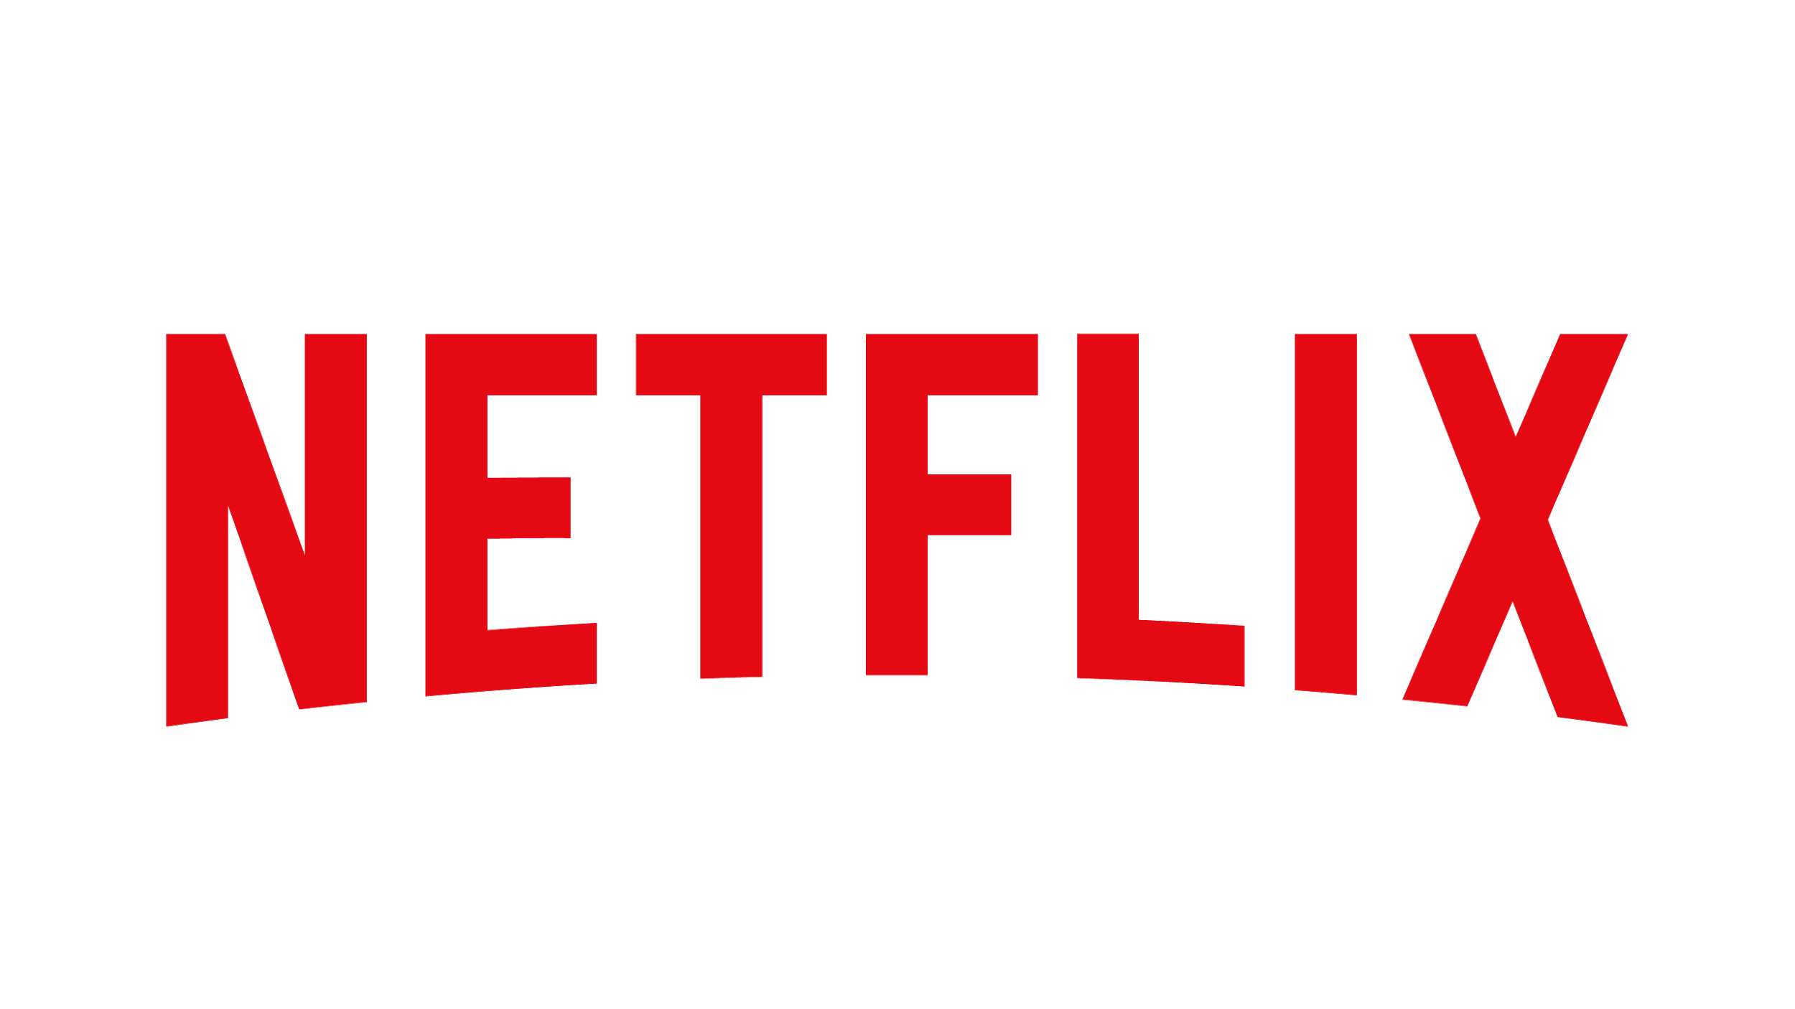
Anatomy of Testing
In Production
A Netflix Original Case Study
Vasanth Asokan

Slide 2
Our goal is to
always be there for you.
99.99%
Notes:
At netflix our goal is to be always there for you.
To be specific, to be available at-least 99.99% of the time
That’s only a downtime budget of 4-5 mins per month

Slide 3
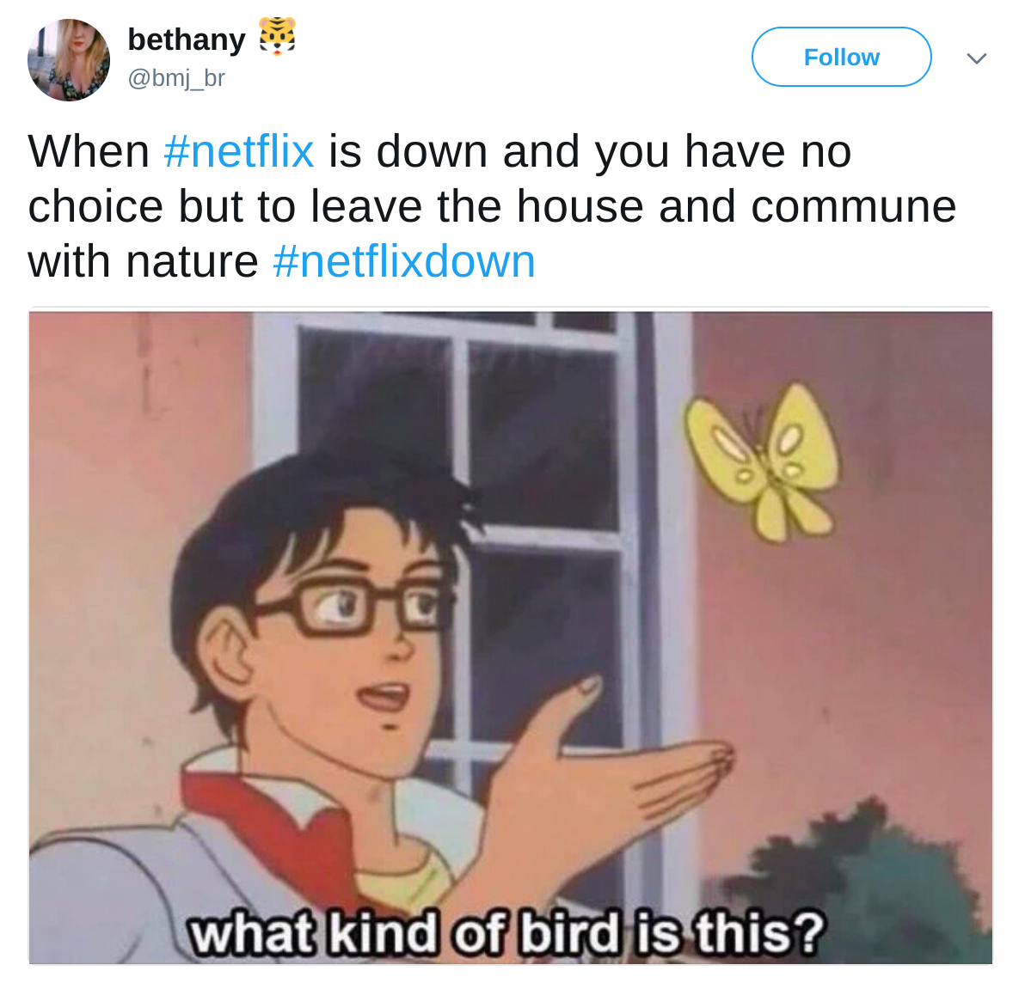
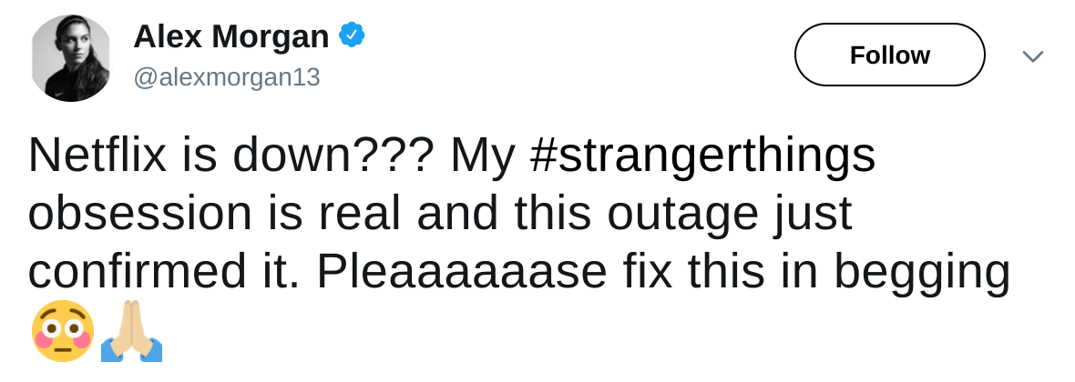
Notes:
While we do try really hard, once in a while this does happen.
We go down and when we go down, people seem to become sad…
There is only one thing that makes us sadder than this, it is when we accidentally do things to make Netflix go down

Slide 4
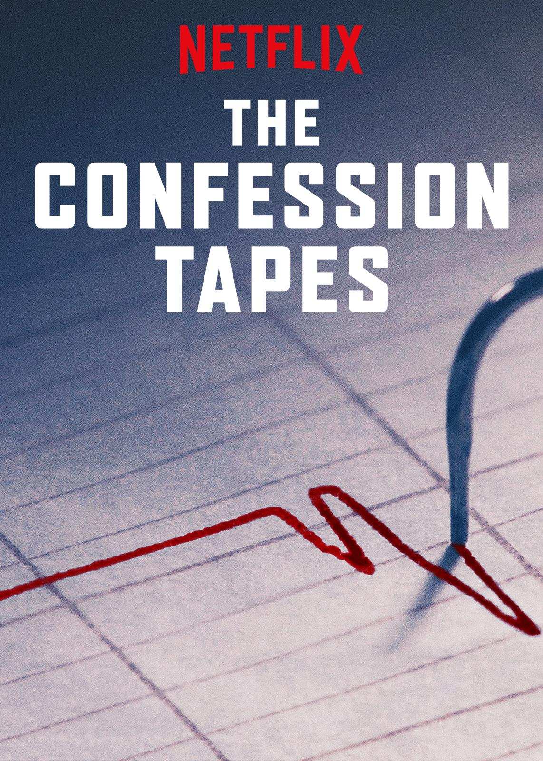
A few years ago...
Notes:
I have a confession to make.
A few years ago, my team deployed software that negatively affected infrastructure causing an outage.
After much heroics, the service was back online and people were happy again
Yet, this led to much soul searching internally

Slide 5
So what went wrong?
Infrastructure clean up code was being tested in production...
Dry Run
Evaluation Bug Unit / Integration Testable
Unused Resource
Calculation Issues
Shows up only in Prod
Notes:
If you break down what really happened
A new piece of code designed to clean up unused resources was being tested in production
And it did the wrong things
I can almost hear a lot of you thinking -- wait, that’s just bad.
Why was it being tested there?
Fair question, but the story goes a little deeper,
This piece of code had two bugs
The actual cleanup was protected by a dry run mode flag,
But it was being incorrectly interpreted and had the opposite effect!
Easily unit testable, had a unit test, but test poorly verified this condition
No reason for this bug to be discovered only in production.
The second bug was in a different part of the code that computed if a resource was actually unused.
It reached the wrong conclusion in certain cases that existed only in production
Hard to recreate or reproduce in TEST because the access patterns for these resources are hugely different between TEST and PROD
The combined effect was a removal of key resources

Slide 6
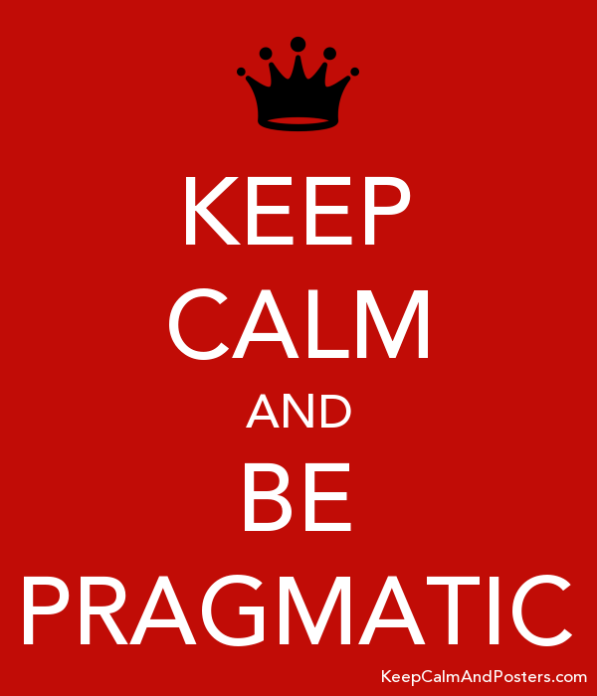
TEST vs. PROD
Notes:
I share this incident not so much to focus on the incident itself, but it highlighted to me for the first time these two polarized viewpoints
Should we test in TEST, or should we test in PROD?
There is one purist camp that says, always test in pre-production -- why unnecessarily affect customers when you could have caught the issue in preproduction?
The other purist camp says, always test in production - what else is more real and tells you for sure that the code is working...right?
The reality of the incident was that we need both kinds of tests - better tests that should have been run in TEST, and those that later should have been run in PROD
So it made me really curious to think about why, when and how to test between these various environments.
Later in the talk, I’ll talk about a more recent case study which brought those questions again to the forefront for me
So I am here to share some of my thoughts with you, that for most of us dealing with existing real-world systems, the answer is to keep calm and approach it pragmatically

Slide 7
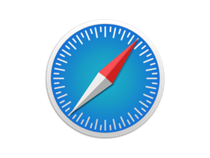
Who am I?
Netflix Customer Devices
Edge
Engineering
Mission Critical
API services
Netflix
Datacenter
Netflix Services
Notes:
My name is Vasanth Asokan, I work on Developer Productivity solutions at Netflix
Specifically, I work for Edge Engineering which is the box you see in the center
Put very simply, Edge Engineering is made up of numerous mission critical API services
They take API traffic from Netflix customer devices, billions of them per day, and orchestrates the communication to the rest of the 100s of Netflix services in a highly resilient and available manner

Slide 8
Disclaimer
Focussing
only on
Edge Engineering
Use Cases
Notes:
My talk today is based on use cases that I saw in and around edge engineering itself and so disclaimer, by no means is this representative of all of Netflix

Slide 9
The road ahead...
Evolution
Case Study
Takeaways
Notes:
Here’s what’s ahead
I’ll start by discussing the evolution of patterns of testing I see in my space at Netflix, and also describe some general problems and solutions there
Then, I’ll focus on a specific case study, and deep dive into how we were able to build up a testing strategy that worked from the ground up
Based on both discussions, hopefully, you will be able to take back some some architectural guidelines
that could help design testing in your next large scale distributed system

Slide 10
Testing Evolution
Volume: Low to Mode: Manual to
Frequency: Intermittent to
HIGH AUTOMATED
CONTINUOUS
Types: Handful to DOZENS
Env: TEST to PROD
Notes:
Let’s start with some facts
Today, testing of Netflix client and server applications in my domain runs AT SCALE
Within a few years, the testing has gone from
a low volume, manual and intermittent mode
to a high volume, highly automated, continuous activity
The things under test have also grown in complexity and variety,
due to the natural increase in Netflix’s complexity, as
as well as the large number of AB tests that are active at a given time
AND! Testing is shifting from being primarily in TEST to more so in PROD

Slide 11
Why the shift to PROD?
Complex non-static distributed systems
High rate of change
Noisy pre-prod
Under investment in testing tools
Inverted testing pyramid
Notes:
How did we get testing shift more to production then?
Through a series of factors
Distributed systems are now complex and highly interconnected
how do you test the integration of multiple services when all of them are undergoing constant change?
And the rate of change is very high - we are very heavily AB testing driven and there are 100s of AB tests active at any given time
This can make pre-production noisy
So the answer is to go where it is expected to be most stable - which is PROD
Tools and automation could have helped stabilize more of the testing in pre-production
Only now are we beginning to invest more heavily in testing tools
In some cases the testing pyramid being inverted was also a cause -- bigger, badder real-world tests more than other kinds of testing

Slide 12
So what did we try first?
Make TEST as good as PROD
Notes:
Who loves their test environment? Let’s have a show of hands…
We tried very hard to make test as good as prod

Slide 13
Making TEST as good as PROD
Let Automation Manage This!
How do you define TEST?
and
How do you keep TEST as defined?
Notes:
It turns out that even defining what TEST should be was tricky...
Is TEST a safe mirror of PROD?
Or Is TEST latest build with features that others need to integrate against?
This just led to us introducing more and more environments over time making the story complicated
Even if defined, the burden of keeping environments in sync with the definition was onto the individual teams
This stopped scaling at some point
So now we know the answer is there is no way we can do this without company wide automation

Slide 14
Making TEST as good as PROD...
What about usage characteristics?
Notes:
Let’s say you do manage to keep the environment as defined
What do you do about the usage characteristics that are completely different?
Pre-prod usage patterns could be wildly different
As an example, for every single build that goes out into production, we see 10-20 builds that go out to pre-production.

Slide 15
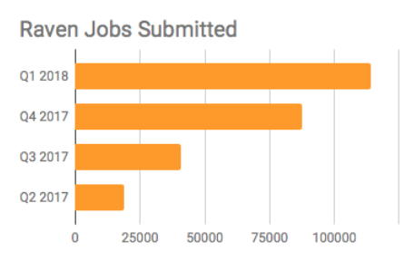
CI/QA Scale
The Steve Factor!
~3X spike
Notes:
Here’s another example highlighting the scale difference
This chart shows job submissions to our aggregated logging system. You see that 3x bump in Q4 2017? We call that the Steve Factor -- its basically when he wired iOS QA automation to tap into streaming test execution logs!
The inside joke is that if we break something, we are more likely to get in trouble with our internal developers than external customers

Slide 16
Making TEST as good as PROD...
What about performance characteristics?
Unavoidable!
Factor management cost!
Notes:
Yet traffic is 1000s of times smaller than in prod
This means that performance characteristics vary too and tests become vulnerable to mismatched performance tuning
There are no great answers for how to efficiently handle scaling and performance tuning for TEST
It seems unavoidable and high, so you have to factor this in.

Slide 17
Making TEST as good as PROD...
How do I get useful data?
Set up periodic
scrubbed data refreshes
Notes:
And finally,
You need fresh and real looking data in your test environment for it to be truly useful
This means setting up periodic data refreshes
You also need to transform your data to mask core PII or Personally Identifiable Information
This is a lot of data to be hunking over from production to test!

Slide 18
Making TEST as good as PROD...
What do you do with third party dependencies?
This is turning out to be hard!
Notes:
Thus there’s a tremendous amount of investment that is needed to make a pre-prod environment truly useful at scale.
This begs the question -- Can we really do this without literally cloning production?
There’s a philosophical question here
Maybe we should be treating our internal inter-dependencies the same way we would an external dependency
We rely on AWS for our cloud. We don’t ask AWS to give us a STAGING version of their machinery to test against, we use their production!

Slide 19
So what else did we try?...
Embrace Testing in PROD
Make it Safer
Notes:
We’ve also put in a lot of energy towards making it safer to test in production
A number of considerations exist to ensure that production is safe for tests

Slide 20
Embrace Testing in PROD
Invest in Sandbox
account abstractions
What about payments and transactions?
Notes:
One of the main considerations is payments and transactions
You do not want your tests to end up creating payments in the real world
So we created special sandbox accounts that can have fake MOPs attached and fake transactions exercised on those.

Slide 21
Embrace Testing in PROD...
Invest in self-service routing
to isolated builds
How do I integrate early against features from other dependencies?
Notes:
Unpredictable integration latency
Different teams push at different cadences
If your goal is to integration test against someone else’s latest change, you might be waiting an unpredictable amount of time for their change to make it to out
So we invested in a self-service routing system to steer testers to isolated builds staged into production

Slide 22
Embrace Testing in PROD...
Make tests mimic
real world patterns.
Embrace remaining risks!
What about unreal usage patterns?
Notes:
Tests create unreal usage patterns
One common pattern is that many production data bases are designed to be read-heavy, and write light
Write heavy, read-light versus DBs designed to be read heavy and write light
Issues
Impossibly wide viewing history - wide columns on databases
Pressure on geo override systems
So you learn to make tests not do these unreal things, and yet some risk remains, you just embrace it. Your systems are probably going to scale better by handling those usage patterns anyway.

Slide 23
Embrace Testing in PROD...
Design bypasses
for test activity
What about side effects to the business?
Notes:
Uncontrolled ripple effects and side effects
Issues
Test account activity if voluminous could end up impacting AB test results, financial results, algorithmic training, etc.
Real customer accounts are stateful. They transition into various states based on calendar time elapsing.
We often had cases where tester accounts would change states abruptly in production and cause massive test failures. These can be hard to predict and guard against
Design bypasses for test activity

Slide 24
Make it possible to test in PROD...
This is also turning out to be hard!
Don’t you wish you had solved for these problems sooner?
Notes:
So overall this is a story of how we played whack-a-mole over time and made these systems better.
Though it can be done, it is very hard to retrofit into a system of growing complexity
When done well though, it can be rewarding!

Slide 25
Where we are now...
Mix of both flavors
Lack of a consistent developer story
Heavier reliance on canaries
Vaguely understood diffuse impacts
Notes:
So where are we now...
We definitely have a mix of both flavors of testing
Lack of a consistent message on testing environments, especially for new developers coming in
Long feedback loops on the quality of builds
for e.g. this led to a trend of relying heavily on production canaries to validate builds across numerous teams
And finally, we have poorly understood cumulative impacts to both systems and developers
Arguably, you have a confused watson caught between Sherlock and Mary and left holding the baby!

Slide 26
Netflix Scale API Migrations
Going from Zero to 60
(w.r.t Testing Strategy)
AND
A Case Study in Pragmatism
Notes:
Let’s look at a more specific case study
I am going to walk through a large scale API migration project that my team is currently a part of
The API migration presented an opportunity to build up a good testing strategy from the grounds up iteratively and pragmatically

Slide 27
Edge API Architecture
Rest of Netflix
Mid-tier
Services
API SERVER
Netflix AWS
bff
bff
bff
Edge Proxy
Java Service Layer
bff
bff
bff
Notes:
Let’s look at the current Edge API architecture first
We have numerous client applications out in the field. All their API needs to render and allow the Netflix UI to function, are fulfilled like so
API requests come to our AWS datacenter through the Edge Proxy layer and hit our main API server
This API server has an interesting architectural pattern
It’s called BFF or “Backend for Frontends”.
The idea is that every client application on the left, has a matching API adaptor or BFF running on the API server.
These are contributed to by the client teams themselves and allow them to innovate independently on their API needs,
It also allows them to do last mile API adaptations and data orchestration.
Currently these BFFs are written as groovy scripts which in turn reach out to a Java API service layer
The Java service layer orchestrates requests to and from the rest of the 100s of Netflix mid-tier microservices for things such as personalization, search, subscriber data etc.

Slide 28
Edge API Architecture
API SERVER
Netflix AWS
bff
bff
bff
Java Service Layer
Device
to Server API
BFF
to Core API
bff
bff
bff
Notes:
Zooming in a little closer, let’s look at the part of the API we wanted to rearchitect
The motivation for the rearchitecture was that the API was reaching runtime scaling limits with running BFFs natively.
So, we wanted to break up the BFFs out into their own application layer.
So we are attempting to go from this...

Slide 29
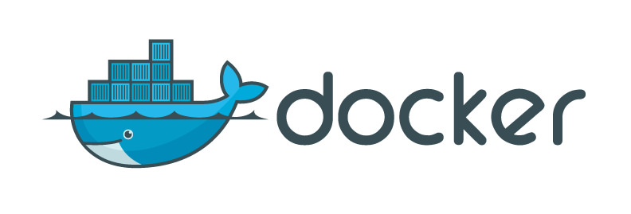
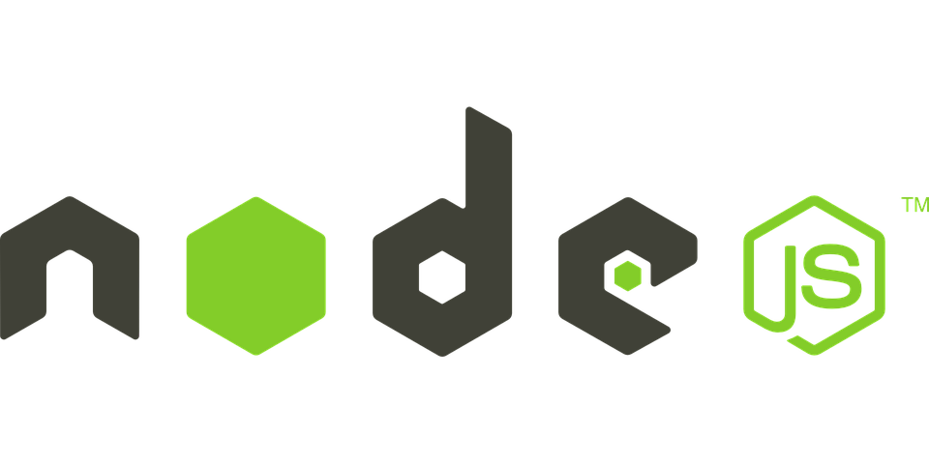
Edge API RE-Architecture
Only UI Tests
API SERVER
Netflix AWS
bff
No Tests
New Graph API
bff
bff
Java Service Layer
Device
to Server API
Server
to Server API
bff
Billions of Requests
bff
bff
Notes:
As you can see, in the rearchitecture, the BFFs run in a separate application layer, as docker containers
We were also rewriting them from groovy (which was a poor ergonomic fit for client developers) to JS and Node.JS
Since the BFFs are now in a separate process, the communication with the service layer has to be over the wire
This meant creating a new server to server API between the BFFs and the remote service layer
We chose to create a new graph API as that gave us the modeling power that was needed for the browse experience
Note that the Device to Server API receives billions of requests per day
During all this, we wanted to keep the Device to Server API exactly the same to give us some footing on the ground
However, there was a bit more to the challenge
This architecture was put in place many years ago. A conscious testing strategy choice was to test only at the UI layer
This meant that there were no tests at the device to server API layer
Does the testing pattern here ring a bell --

Slide 30
Edge API Architecture - Evolution
Notes:
YES - We had the classic inverted test pyramid
The inversion mattered now, because the device to server APIs had both grown and evolved over the years time
They were in multiple flavors and none of it was documented
It was all tribal knowledge
Starting to feel nervous?

Slide 31
Essentially...
Notes:
This is perhaps how the developers tasked with the migration were feeling!

Slide 32
A few months in...
Dev Start
Dev Complete
UI Testing
Canary
Production
No Docs
Slow Tests
Poor Test Coverage
Notes:
And sure enough, once we undertook the migration a pattern developed...
Going from start to Dev Complete took a lot of time because there was no API documentation to go by
Going from dev complete to UI Test complete was also a slow feedback loop because, these are end to end UI test
Even if UI testing completed, it was clearly not sufficient because canary verification uncovered numerous bugs and thus, we went right back to development
The project was going months with no features getting migrated. And this was just on one platform, iOS -- we had many others to complete!

Slide 33
Testing Strategy - Ideal
Manual Tests
Cost,
Confidence
End to End UI Tests
Number,
Speed
Stability
Functional Tests
Integration Tests
Unit Tests
Notes:
So we realized we had to start from zero and build up a solid testing strategy to get us moving
This is the ideal testing pyramid
You start with a large body of unit tests at the bottom
And you build up towards integration, functional, and then end to end / manual tests
The idea is that tests at the bottom of the pyramid are cheaper, easier to write, generally more numerous
As you go up the pyramid, you build up the confidence, but at an increasing cost

Slide 34
Testing Strategy - Unit
BFFs - Translation Layers
Manual Tests
End to End UI Tests
Functional Tests
Integration Tests
Unit Tests
Notes:
And so we started at the bottom with unit tests
Going back to what the BFFs are -- these are API adaptors, essentially translation layers taking data from one API, and filtering, decorating or transforming it to client needs.
Thus these BFFs contained very little business logic and are mostly made of orchestration / adaptation code
Thus unit tests very of very low value

Slide 35
Testing Strategy - Integration
Schema
Manual Tests
Mocks
Mocks
Mocks
End to End UI Tests
Integration Tests
Graph API
Functional Tests
bff
Integration Tests
Unit
Tests
Notes:
Integration tests still seemed promising.
They offered a way to test the BFF at its edges thus verifying that all the internal components of the BFF worked fine.
Integration tests have few moving parts and thus are a lot more stable.
To support true integration tests we needed mocks.
Since we were designing the new server to server Graph API, we decided to invest in making the API be schema driven
Schema driven APIs are great
They naturally lend themselves well to not only generating the API implementation and API clients,
but also documentation and mocks based on sample data
While this was upfront investment, it promised to be a worthwhile one

Slide 36
Testing Strategy - Functional
Manual Tests
How do we discover and cover the large
API surface area?
End to End UI Tests
Functional Tests
Integration Tests
Unit
Tests
Notes:
However, the key to cracking this migration was the wide API surface area, and ensuring coverage
Integration tests via manually specified mocks would only get us so far.
We knew that we had to focus on exercising functionally in a way that mimicked what we were seeing in production
And yet, we didn’t want to push that responsibility further up into the more expensive layers of the pyramid.
We wanted to find a way to make the middle layer of the pyramid work for us easily and scalably
If you noticed, by now our textbook testing pyramid shape is starting to look more like a...

Slide 37
Test Pyramid?
Manual Tests
Testing Diamond
End to End UI Tests
Functional Tests
Integration Tests
Unit
Tests
Notes:
DIAMOND...
We decided to embrace it
We decided to embrace it because
it felt pragmatic, it felt meaningful and it felt iterative...
Maybe we will have opportunity to influence this shape better as we go
So on we dove into functional testing...

Slide 38
Functional Testing
What do you do when
there are no contracts?

Slide 39
Functional Testing Strategy - Duplex Testing
PRODUCTION
Tester Account Credentials
Migrated BFF API
/ios/new
Request: { url: ...,
path: ...,
headers: ...,
payload: ...
}
JSON compare / fuzzy match of sanitized payload
Existing
BFF API
/ios/old
Generated
schemas
Notes:
We started with a simple idea - Duplex Testing.
The idea was that all current expectations are represented by the existing BFF API implementation
So why not take a tester account, and issue the same request to both the old implementation and the newly migrated implementation and compare them for equivalency
This was a great starter approach, as the developer could check for high level functionality match for simple use cases
This technique also provided an interesting side benefit
We could start analyzing the old implementation and generate a schema representing the expectation
These could feed back into improving the integration tests, as with a schema, we could now more simply assert against mocks provided by the downstream API
This was still only a basic coverage of the surface area as it was upto the developer to codify these input conditions one by one
So how do we scale this out?

Slide 40
Scaling Out Functional Testing - Prod Capture and Replay
PRODUCTION
TEST
Customer Devices
Migrated
BFF API
/ios/new
JSON compare / fuzzy match of sanitized payload
Existing
BFF API
/ios/old
PII Masking
Existing
BFF API
/ios/old
Generated
schemas
Captured Requests
Notes:
Our approach to scaling this out was production capture and replay
We could go into production and capture a large body of requests from customer devices actual customer devices and persist them
Note that when persisting customer data, you will have to take care of morphing or masking core PII.
We could take this large body of requests from persistence, and duplex replay them in TEST just like the previous functional testing approach
As an example
for a single feature in the API that was being migrated, we captured 24 hours of traffic from across the globe.
We were able to replay the requests and identify numerous corner case bugs
Things that no one knew were part of the contract.
The identified bugs were codified back into new duplex functional tests or integration tests via a schema
This approach allowed us to gain immense confidence in feature migration, and helped really accelerate the velocity
It also continued to help feed the bottom layers of the pyramid!

Slide 41
Functional Testing Strategy - Environment Implications
Ha! You can’t test WITH production data over there
Prod Capture and Replay
Duplex Testing
Ha! I bet you aren’t that stable
TEST
PRODUCTION
Notes:
Did you notice something interesting in the previous two functional testing techniques?
The basic duplex test could be done in PRODUCTION because we used tester accounts
However the prod capture and replay duplex test could only be done in TEST
We cannot replay in production, because we could be harming actual customer data with a reissue of these types of requests
Because the production data is masked and refreshed into our test environment, we could (after a time delay) replay these requests safely in the TEST environment
Thus our core interest in the replay technique was the data, not the production systems themselves
Yay! For the test environment, it unlocked our ability to test WITH production data rather than test IN PRODUCTION
Yes it was more unstable than prod would have been,
But since we were testing in this duplex mode,
instability showed up in both old and new implementations, allowing us to filter for instability and focus on the true failures

Slide 42
Functional Testing - Production Verification - Canaries
PRODUCTION
Customer Devices
Migrated BFF API
/ios/new
Canary Analysis
Edge Proxy
Existing
BFF API
/ios/old
Captured
Logs
Notes:
The stability problems of doing capture replay in TEST are real. Filtering out failures can mask real issues in downstream implementations
Thus the final step of the functional validations was to run real canaries in production,
We put both versions of the API out into the production
Expose a small percentage of actual customer traffic to old and new equally
Then run sophisticated canary analysis algorithms on the metrics coming from both implementations, and compare and verify that both client and server metrics were statistically equivalent
If not, we were able to pull failing request response logs from the canaries
These logs not only allowed us to debug and triage the issue better
But they could then be codified back into duplex functional tests

Slide 43
Testing Strategy and Environments
Manual Tests
PRODUCTION
End to End UI Tests
Canaries
Duplex Testing
Capture / Replay
TEST
Integration Tests
LOCAL / CI
Unit
Tests
Notes:
And so finally here is where out testing strategy finally settled...
It’s interesting to observe how the different testing environments proved their value across the different layers
With this strategy, we were now able to see a much more predictable path to production increased migration velocity
We see this testing strategy carrying over into steady state too with variations of course
Once migrations are complete duplex and capture / replay could continue to play a role
An interesting variation of those two techniques is to leverage them to catch build over build regressions
They could also play a key role in helping keep mocks in sync, and/or catch API drift

Slide 44
Pushing Even More Boundaries
What if we could simulate and test complex conditions for UI tests?
PRODUCTION
Notes:
While this helps us get past the migrations, we are continuing to think of ways of improving the testing scenario
We didn’t discuss as much about the remaining layers in the testing pyramid -- but what what if we could help make black box tests or UI tests become more efficient?
As an example, Netflix supports 1 stream and 2 stream plans. If you are on a 1 stream plan and you have a second person attempting to watch on your account simultaneously, we would like the playback terminated with the error message that too many people are watching.
But how do you test this condition? It is a painful scenario to setup in a device lab

Slide 45
Simone
Distributed Systems Simulation
in Production
Notes:
In fact, we have a distributed system simulation framework that we have been operating for a few years now.
It supports the use case I just described. Our device certification teams use this to black box test partner integrations.
There’s no other way for these partners to test fully baked in client implementations that cannot take in mocks, or redirect to artificial environments
With Simone, a service owner can inject arbitrary functional behavior overrides or payload changes in the API responses of their microservice
And any tester can ask for that override to be applied to their test via self-service tools.
Let me show you a quick demo of how simple and easy it is to do this sort of testing

Slide 46
Simone Demo
Notes:
Let me show you a quick demo
We are excited to introduce this simulation capability developers at the API layer case study we saw previously
We have a chance to now build the simulation framework clients into the BFF now, as we are rebuilding the API platform and testing strategy

Slide 47
What about Chaos experiments?
What happens to customer sessions when we run chaos experiments?
PRODUCTION
Learning to Bend, But not Break - Haley Tucker, QCon NY 2018
Notes:
Netflix does Chaos testing at scale...in production. We have everything from monkeys killing servers, to large scale chaos kong exercises where we fail entire regions.
That topic deserves its own talk, so I won’t go into the details here. If you are interested, I’ve linked to a great talk by my colleague Haley Tucker. She gave it at QCon NY this past year
I highly recommend it to learn how to bend systems to learn their breaking points
What if we could push on the idea of failure experimentation for UI testing?
We are starting to think of ideas of blending chaos testing, with simulation testing and understand user session behavior
It could be another way to amp up your production testing to do large scale experiments and verify behavior at scale.

Slide 48
Concluding Thoughts
Embrace the differences between TEST and PROD
Invest early in solving for their challenges
Watch out for ROI inflection on TEST
Architectural pivots are a great opportunity for rethinks
Start with a pragmatic testing polygon shape
Make more ideal as you go
Amplify your last mile testing
Simulation and Chaos Testing are next frontiers
Notes:
TEST and PROD are different, embrace the differences
Test is still useful to test with production data
Also useful as an integration stack
But nothing will remove the need to finally verify your software in production
Solve for the unique challenges in either environment from the beginning!
It can be harder to retrofit
Look out for opportunities to rethink your testing strategy - such as architectural pivots
Even though it may come at extra cost, it will be worth it for your developers
Find a pragmatic testing polygon shape right for your case
Don’t try to fit a textbook shape. Understand and embrace the fact that you can evolve the shape to a better one as you go
Embrace production simulations and chaos experiments.
They amp your real world functional and resiliency testing capabilities and really are the next frontier

Slide 49
Rate Today’s Session
Session page on oreillysacon.com/ny
Notes:
I hope you found my talk useful
I would love to hear your feedback positive or negative!
Please rate the session as shown in the screen shot, or via the mobile app

Slide 50
Questions?
Notes:
And I’ll be happy to take any questions!

